Slide 1

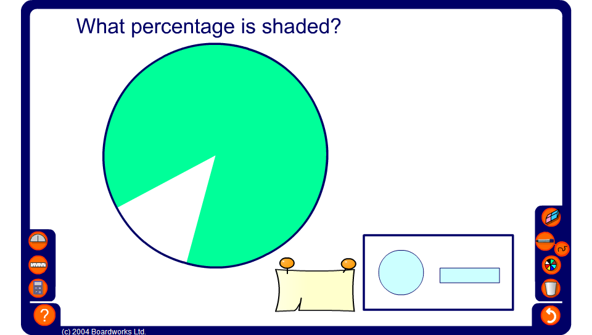


Estimating percentages
Notes:
Use this activity to practice estimating percentages on a circle and on a bar.
Pupils could be given points found by subtracting their estimate from the actual value. The pupil with the lowest score would be the winner.

